Slide 1
AUTOMATION OF COUNTING OBJECTS BY USING DIGITAL IMAGE PROCESSING

Slide 2
AIM
Our aim is to estimate accurate count of object in the image. So we are going to develop a program which detects the objects in an image. The program should automatically detect the desire object and count the number of objects in that image by detecting the edges of an image.

Slide 3
INTRODUCTION
Object counting is a very common task performed in different industries
Object counting is used to get certain number of elements from images.
These elements act as a source of information for quantitative analysis, motion tracking and qualitative analysis.

Slide 4
Proposed system
In our project we are going to detect exact objects on the image by detecting edges and shapes of the image
Automatic counting is objective, reliable and reproducible, cells, RBCs, fish, eggs.

Slide 5
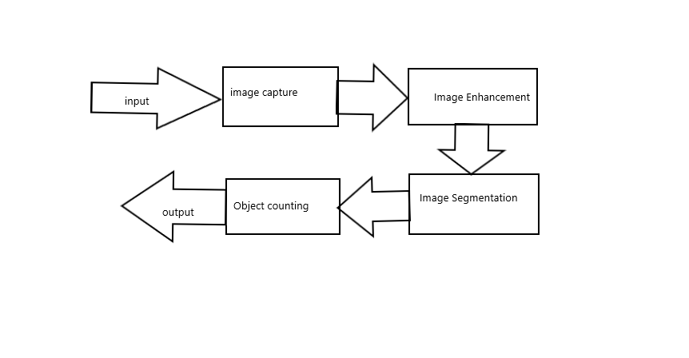
Architecture

Slide 6
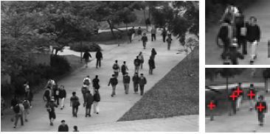
Applications

Slide 7

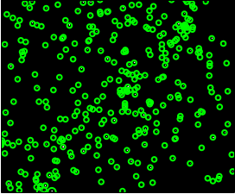

Slide 8
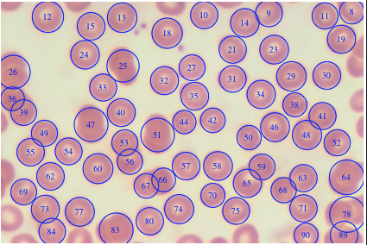

Slide 9
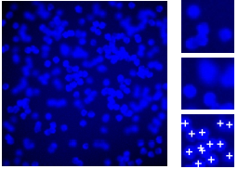
Applications

Slide 10


